Slide 1

INTEGRATED CAPSTONE PROJECT CHECKPOINT - 3
Sri Praveena Geddam(DELBC8001)
Hebbar Sumukh(DELBC8002)
Niyatee Nibedita Panda(DELBC8003)
Yogam Rakshana R(DELBC8004)
Ukash Bhat(DELBC8005)
Batch – H
Group - H1

Slide 2
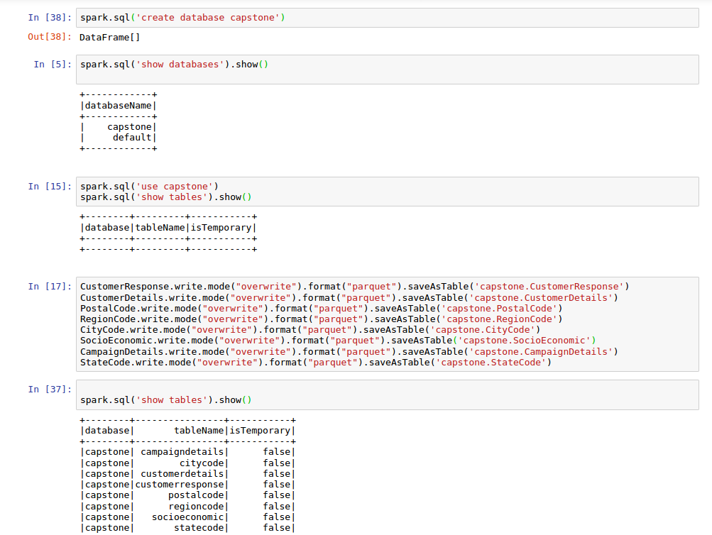
Task 3.1 – Data Analysis using Big Data Tools
The dataset was loaded into Spark DataFrame and was then loaded into Hive Tables in the optimal format (Parquet).

Slide 3
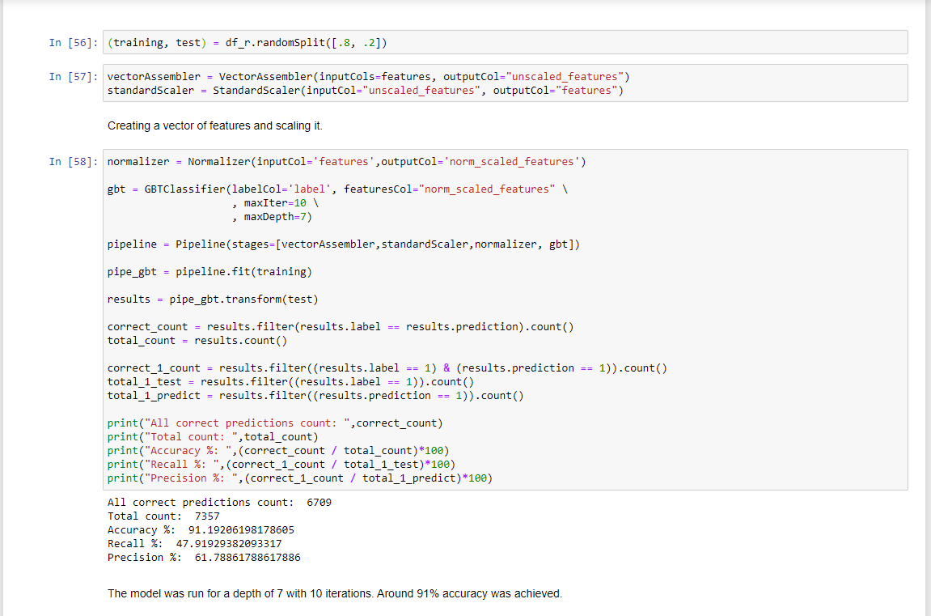
Task 3.1-Pyspark MLlib
The data was split into training and testing (80,20) and was given to a pipeline of vector assembler , standard scale and normalization.
This was fed to a Gradient Boosting classifier (Chosen in task 2,4). The model had an accuracy of around 91%.

Slide 4
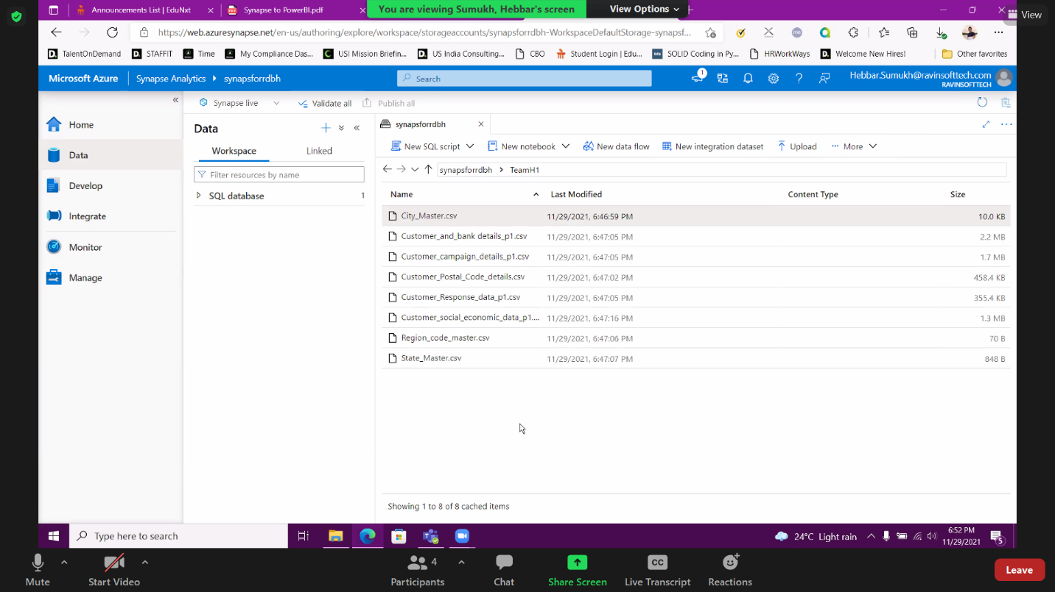
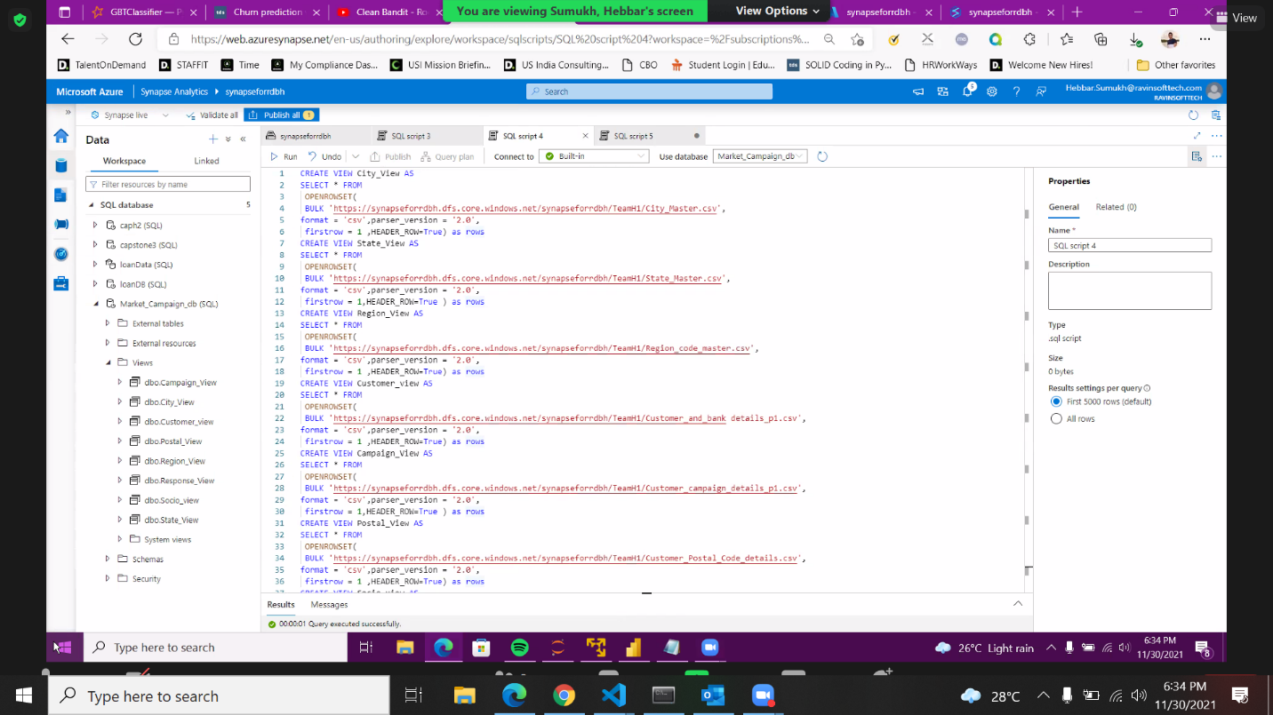
Task 3.2 – Data Analysis on Cloud
Created a folder with some valid name to upload your datasets to azure synapse storage Gen1
Created a serverless SQL pool to query the data from storage gen1 and create view tables

Slide 5
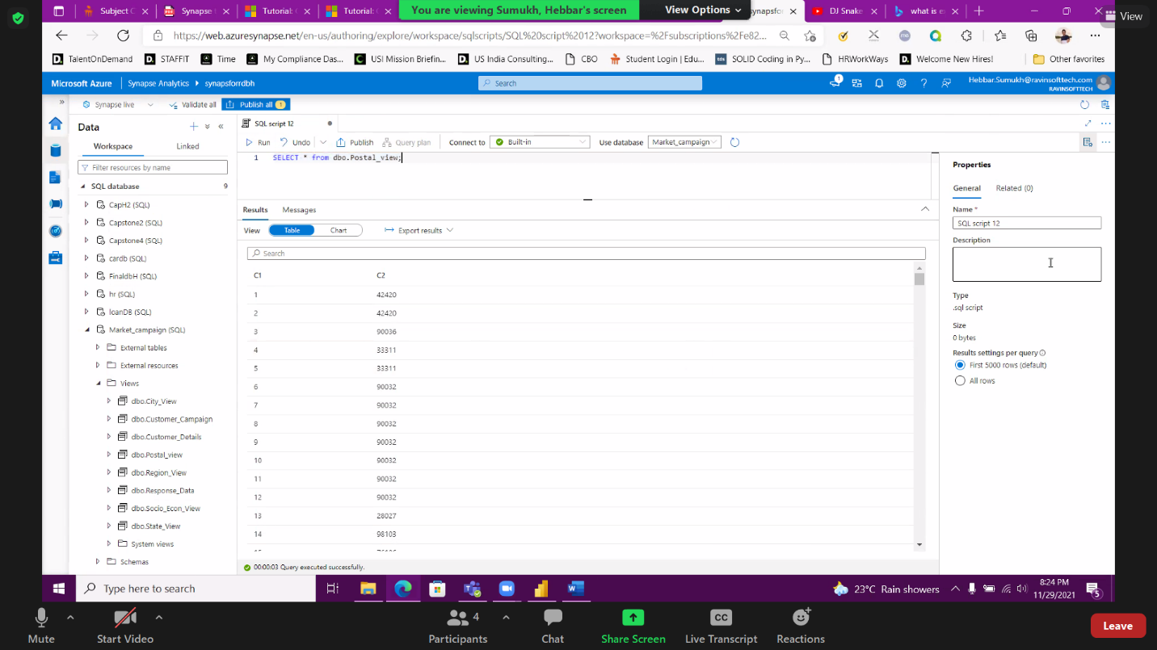
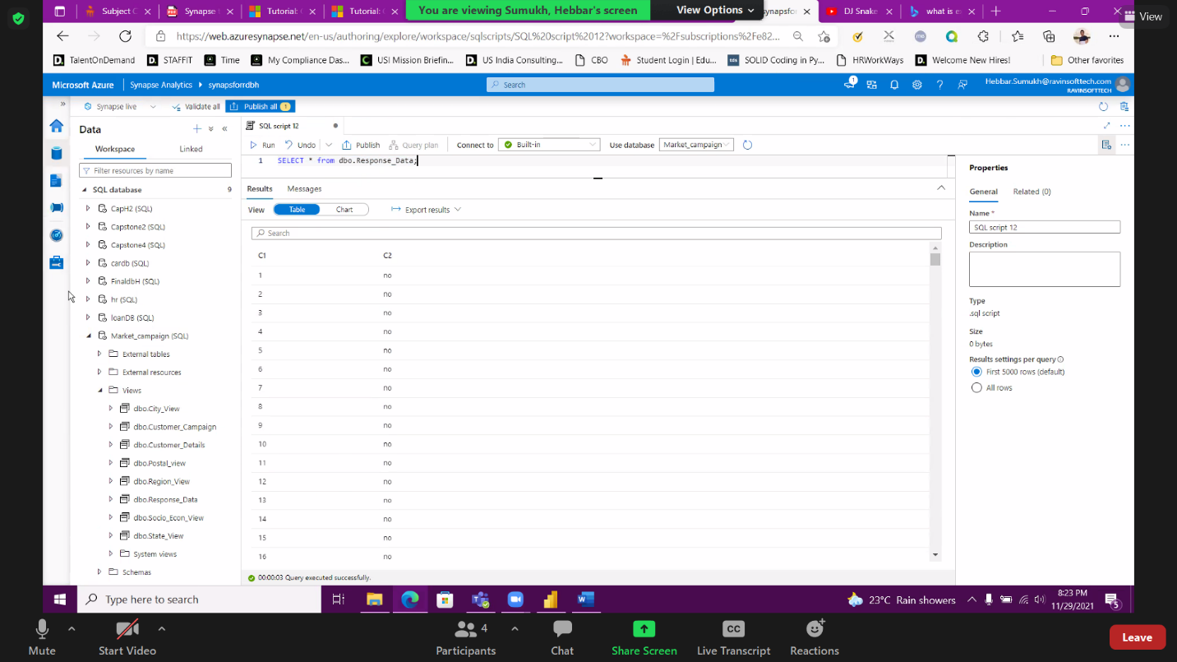
Checked the view created by writing select queries and saved all the tables

Slide 6
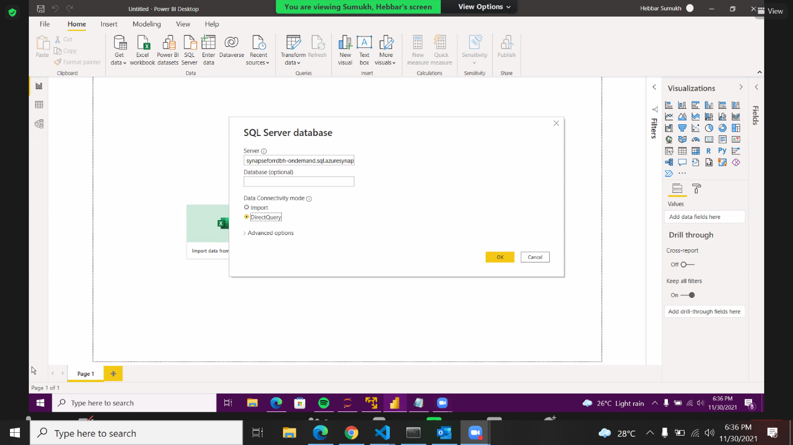
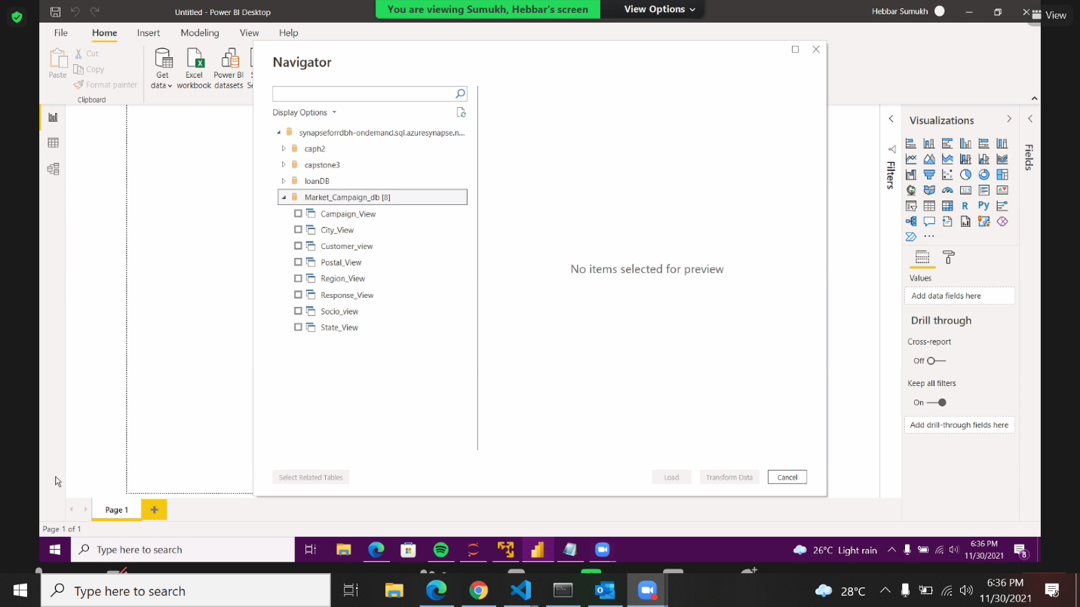
Linking the Power BI to SQL Serverless database and viewing the list of view tables in Power BI
Provide Synapse- Serverless SQL endpoint and selected “Direct Query”
List of view tables in Power BI

Slide 7
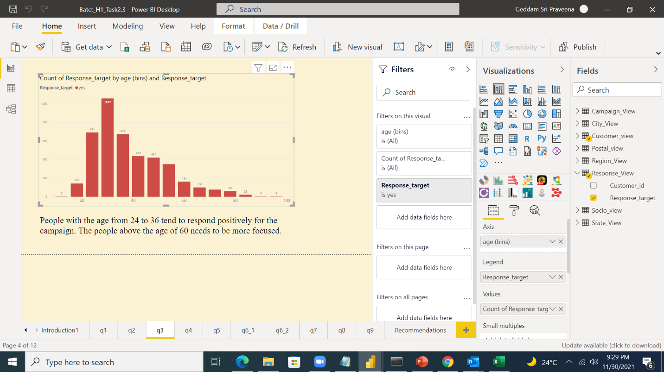
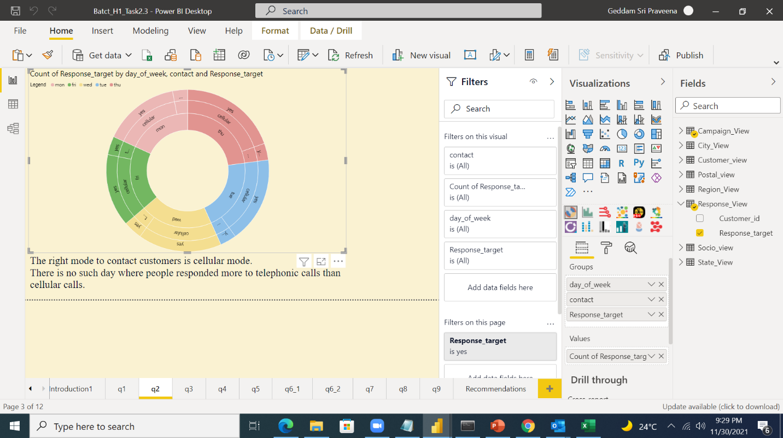
Various Analytics on Power BI
People with age group 24 to 36 tend to respond more
The right mode to contact the customers is the cellular mode

Slide 8
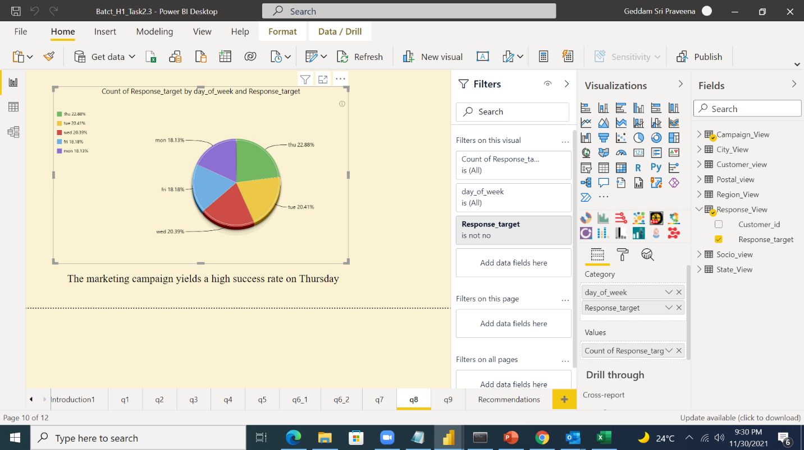
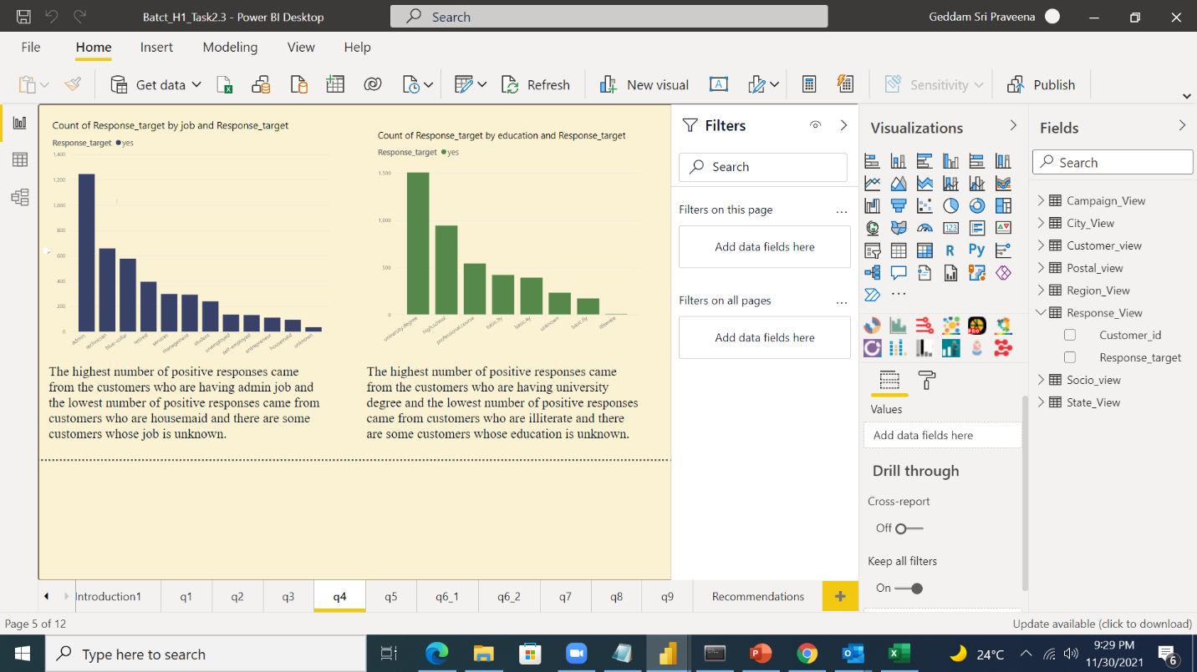
Thursday yields a high success rate
The highest number of response came from the customers who are having job and who are aving university degree

Slide 9
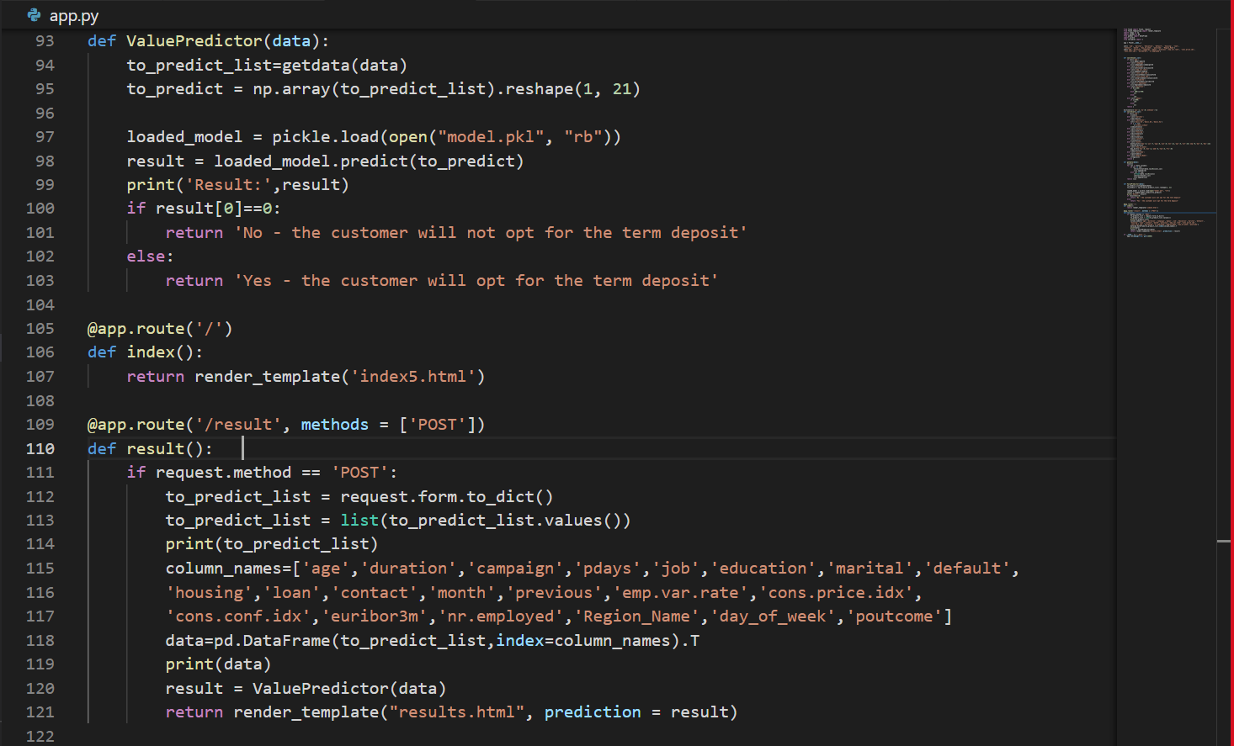
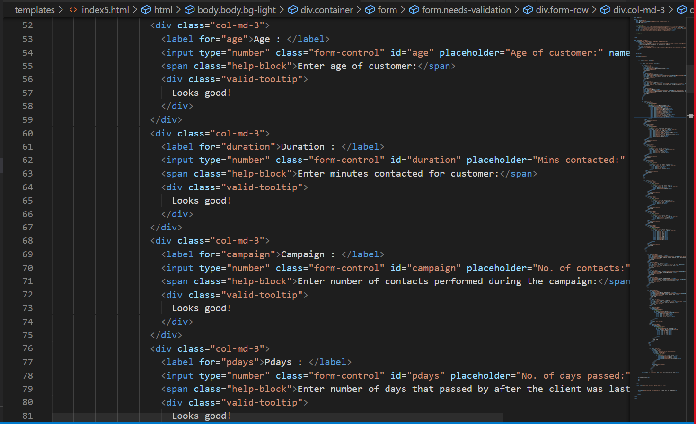
Task 3.3 – Deployment of Models using Flask

Slide 10
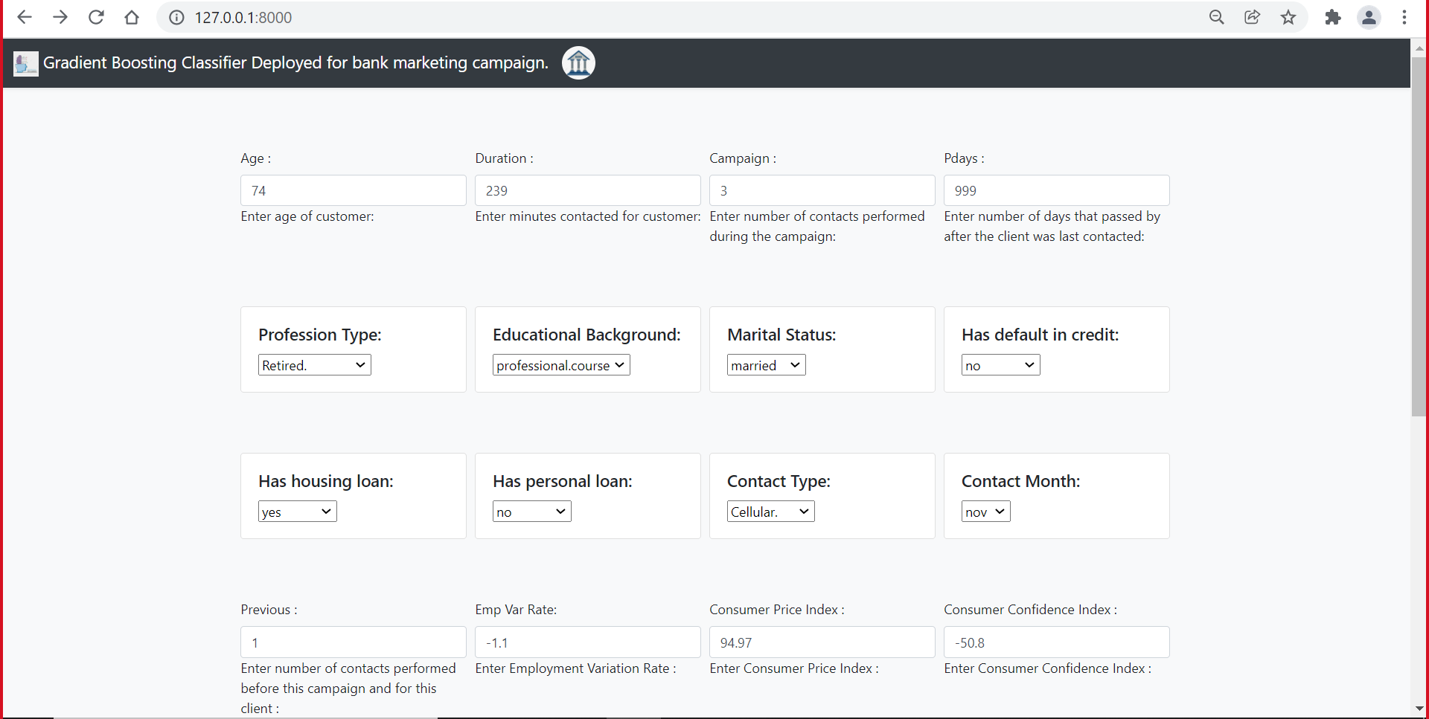
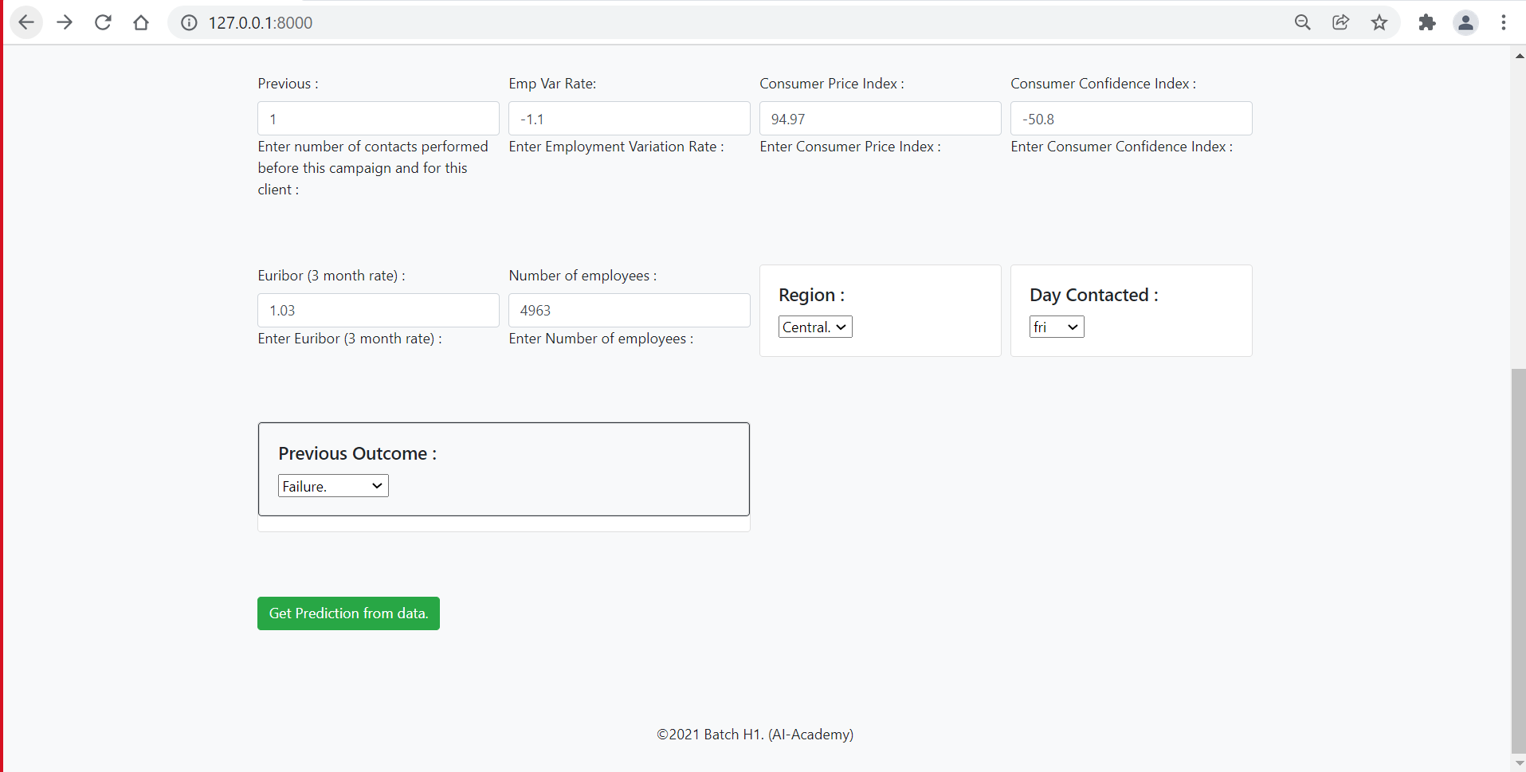
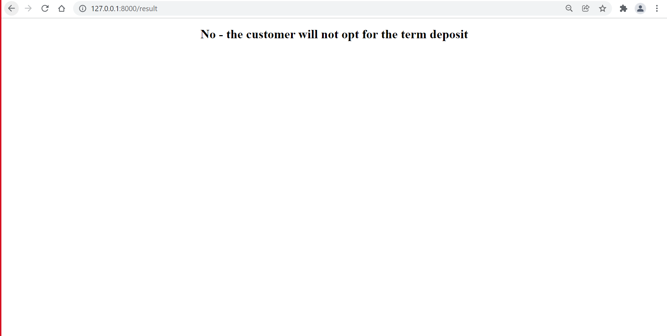
A data was tested on the model, and prediction was done
The webpage is given here.

Slide 11
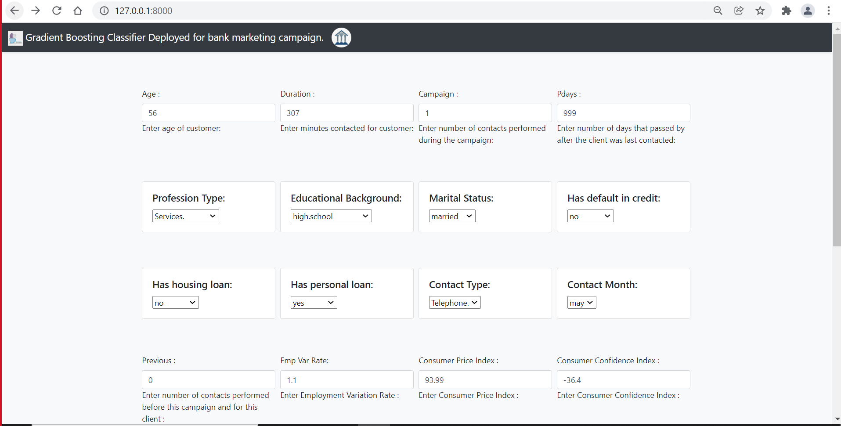
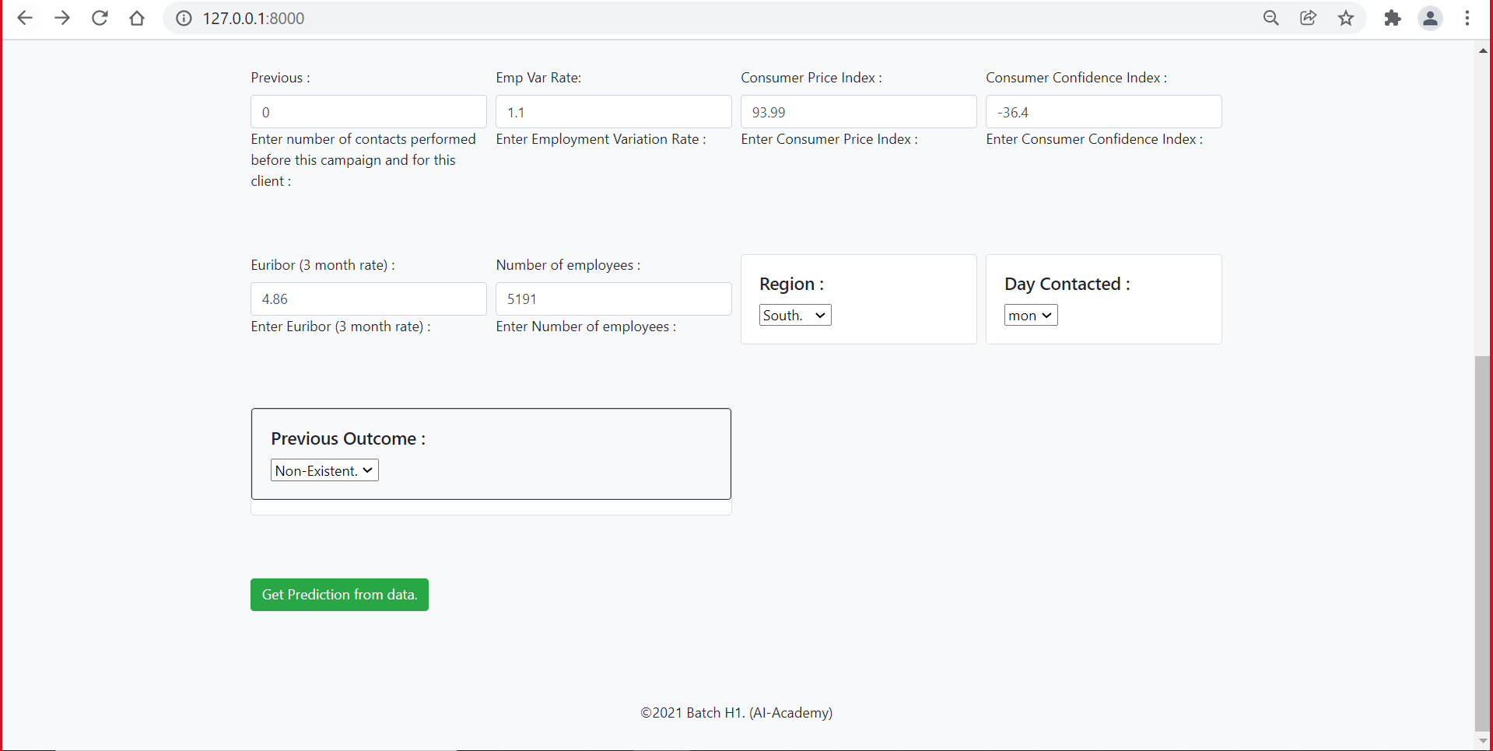
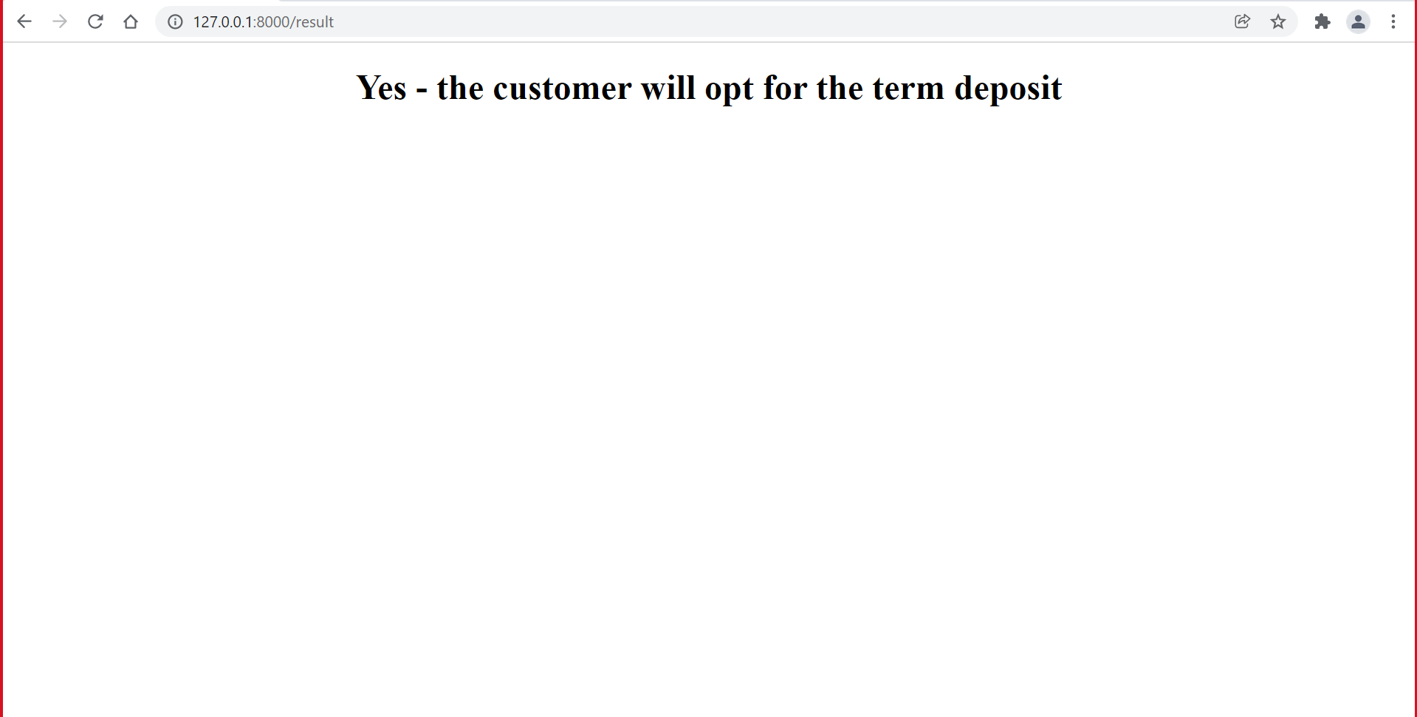
A data was tested on the model, and prediction was done
The webpage is given here.

Slide 12


